Slide 1

Impact of Food Delivery Delays on Order Cancellations
Case studies
Presented by:
Rohit Jain

Slide 2
Introduction
Food delivery platforms are growing rapidly, but with this growth comes operational challenges - one of the most critical being delivery delays. Timely delivery plays a crucial role in ensuring customer satisfaction, as customers expect their food to arrive fresh and within the promised time. However, even slight delays can negatively impact the overall customer experience. Delays not only reduce customer satisfaction but also increase the chances of order cancellations and poor ratings. In this analysis, we aim to explore the relationship between delivery delays, order cancellations and customer ratings. By identifying patterns and trends, we can better understand the key factors contributing to delays and how they influence customer behavior.

Slide 3
Business Background
You are working as a data analyst in a food delivery company.
The company is facing:
High delivery delays
Increasing cancellation rates
Decreasing customer ratings
Management wants to identify the root causes and improve operational efficiency.

Slide 4
Business Objective
Analyze the relationship between delivery delays and cancellations
Identify peak time inefficiencies
Evaluate delivery partner performance
Improve customer experience
Provide actionable recommendations

Slide 5
KPI’s
The following KPIs were used to measure performance:
Total Orders → 220
Total Revenue → 127K
Cancellation Rate → 28.64%
Revenue Loss → 36K

Slide 6
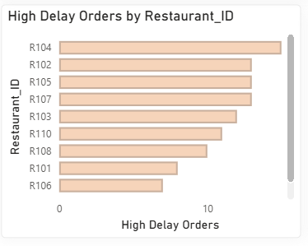
Business Questions / Challenges
Shows how many highly delayed orders are associated with each restaurant.
Some restaurants have significantly higher delays than others.
Helps identify underperforming restaurants and operational inefficiencies.

Slide 7
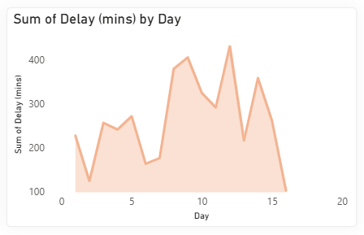
Business Questions / Challenges
Shows the total delivery delay accumulated on each day.
Certain days have significantly higher total delays, indicating operational pressure.
Helps identify peak days where delivery performance needs improvement.

Slide 8
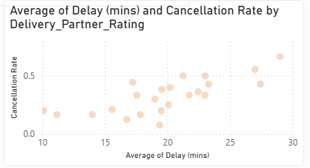
Business Questions / Challenges
Lower-rated delivery partners show higher average delays and higher cancellation rates.
Higher-rated partners tend to deliver faster with fewer cancellations.
Indicates a strong link between partner performance, delivery efficiency and customer experience.

Slide 9
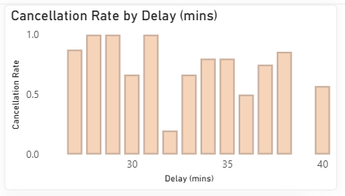
Business Questions / Challenges
Orders with higher delivery delays have the highest cancellation rate.
Moderate delays also contribute significantly to cancellations.
Orders with low delays have the lowest cancellation rate.

Slide 10
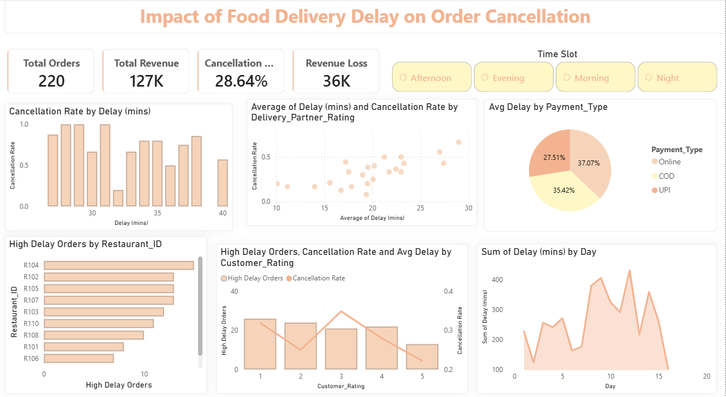
Dashboard

Slide 11
Recommendations
Increase delivery partners during peak hours
Improve delivery time prediction
Optimize underperforming restaurants
Monitor high-delay orders in real time
Provide compensation for delayed deliveries

Slide 12
Conclusion
Delivery delays play a critical role in shaping customer experience and business outcomes. As delays increase, the likelihood of order cancellations also rises, while customer ratings tend to decline. This clearly indicates that delay management is directly linked to customer satisfaction and retention. By minimizing delivery delays, the company can not only enhance the overall customer experience but also reduce cancellations and prevent potential revenue loss.

Slide 13
THANK YOU!

